Slide 1
Top 5 technology trends in the energy industry and how they will impact you
Presented by Mark Kovacevich and Chris Steele

Slide 2

Why is technology important?

Slide 3
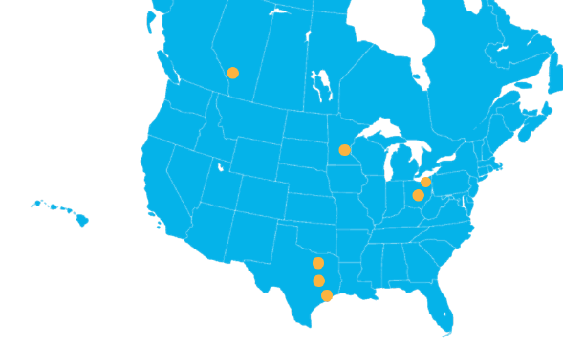
Improving – Geographical Layout
8
OFFICES
Atlanta Calgary Cleveland College Station Columbus Dallas Houston Minneapolis

Slide 4
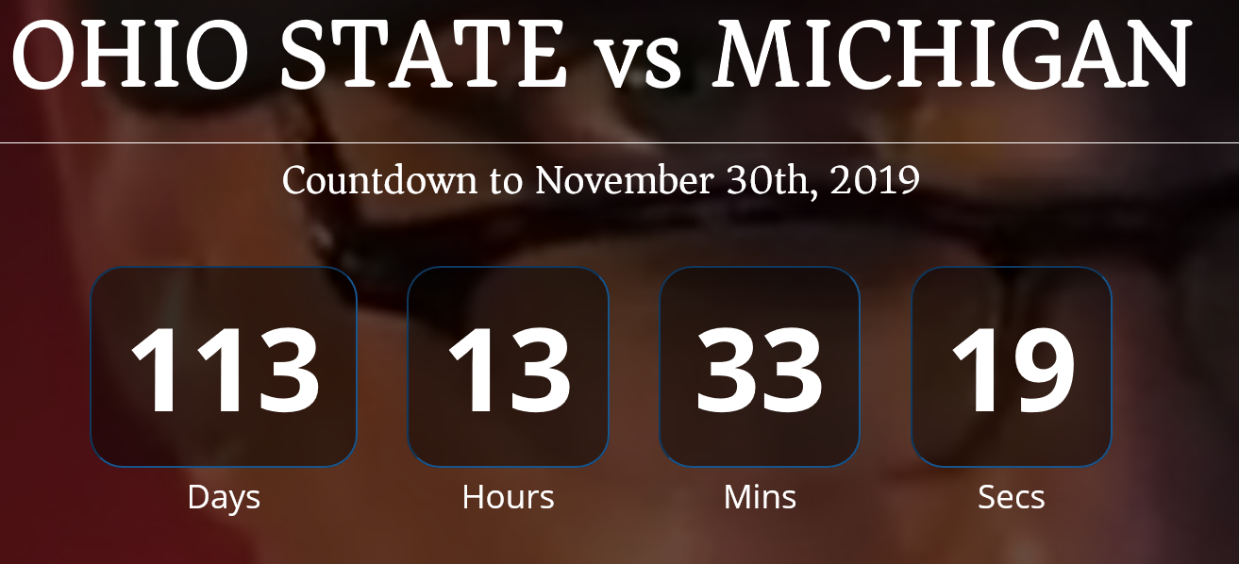
Mark Kovacevich
North American President of Operations
From Columbus Ohio
Married with 2 girls
Technical background, Mergers and Acquisitions
20 years of IT industry experience
Bachelors in Finance from The Ohio State University

Slide 5

Chris Steele
Director of Consulting
From Lewis Center, OH
Married with 4 kids
Full-Stack Developer (.NET)
9 years of IT industry experience
Bachelors in Computer Information Systems at DeVry University
Masters in Information Systems Management at Keller Graduate

Slide 6
Goals
Identify top trends
Explain why they are important
Describe action items
Recap

Slide 7
What are the top energy trends?
Cloud Computing
Internet of Things
Business Intelligence
Artificial Intelligence
Digital Twins

Slide 8
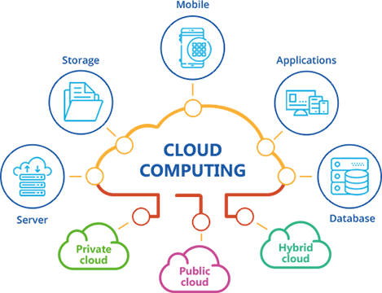
Cloud Computing
Internet of Things
Business Intelligence
Artificial Intelligence
Digital Twins

Slide 9




Cloud Computing
What is it?
The practice of using a network of remote servers hosted on the Internet to store, manage, and process data, rather than a local server or a personal computer.

Slide 10
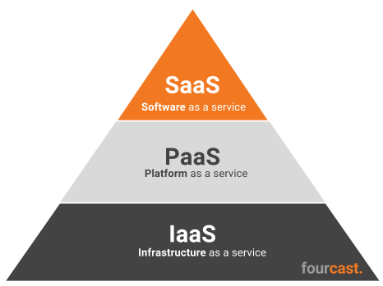
Cloud computing
How is it being used in the energy industry
Reduces IT operational costs by
No physical servers
Always up-to-date
High availability
Easy performance scaling (up/out)
Easily expand geographically
Notes:
Other notes:
Outsource billing
Active purchasing
Ease of use
Direct communication
Exposed APIs

Slide 11
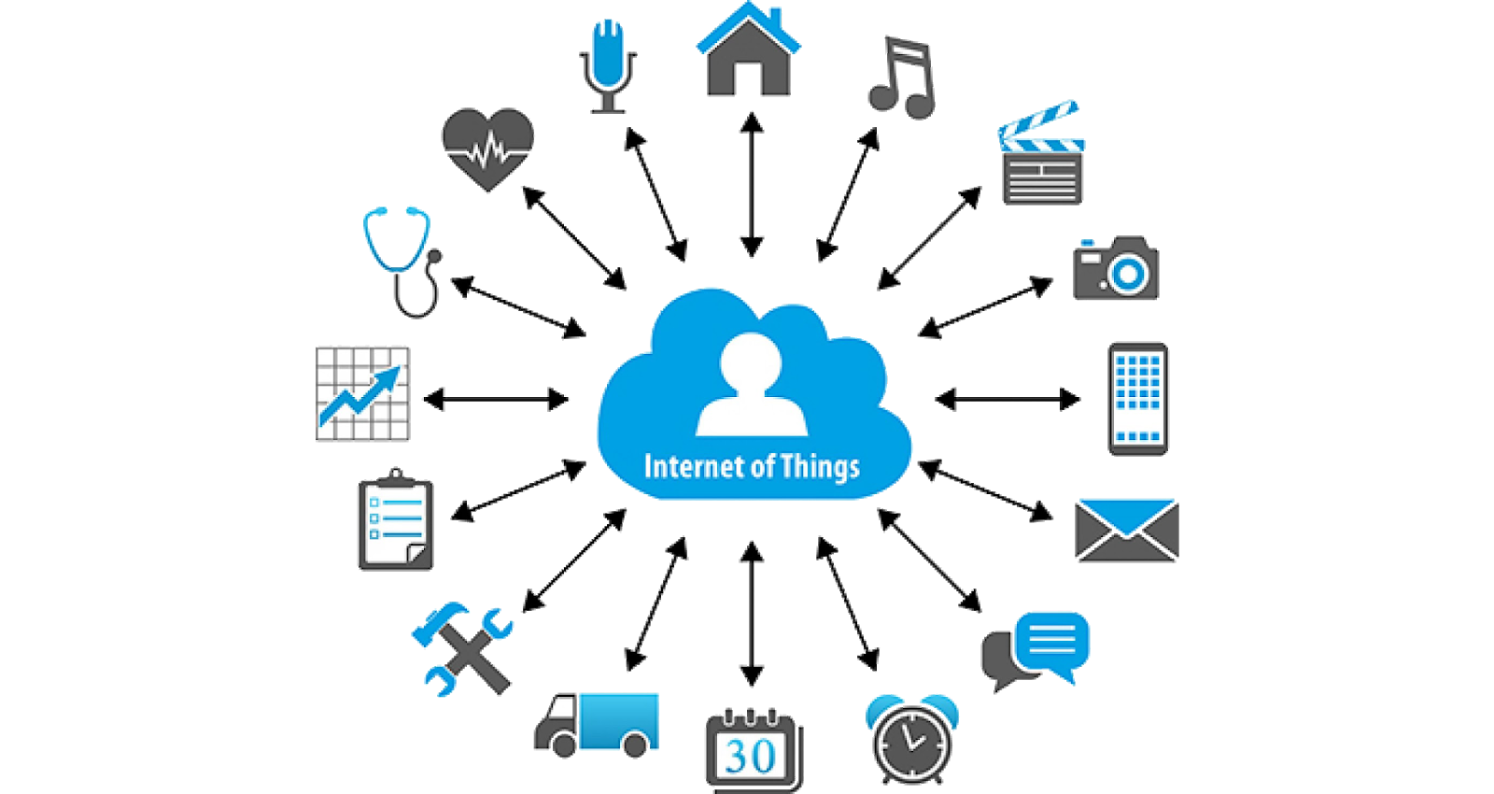
Cloud Computing
Internet of Things
Business Intelligence
Artificial Intelligence
Digital Twins

Slide 12
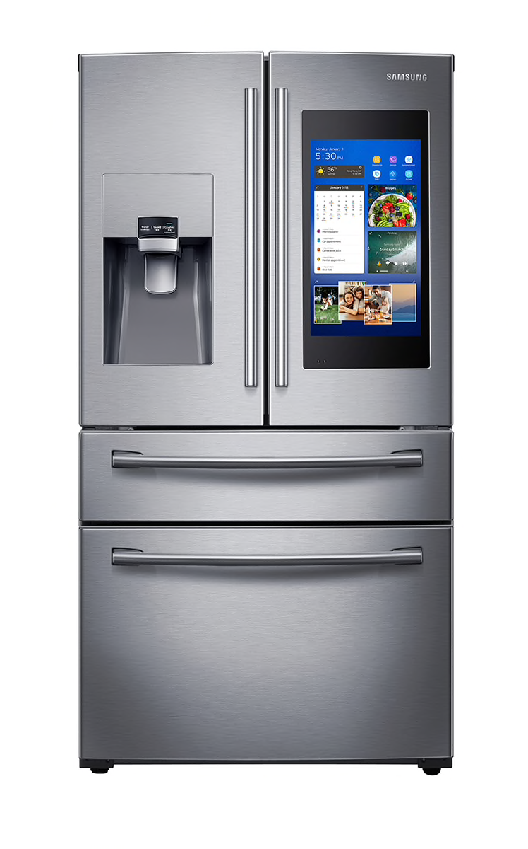
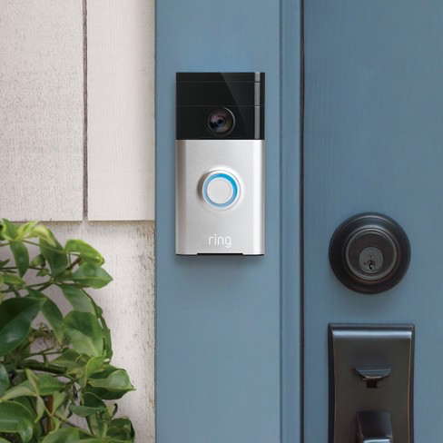
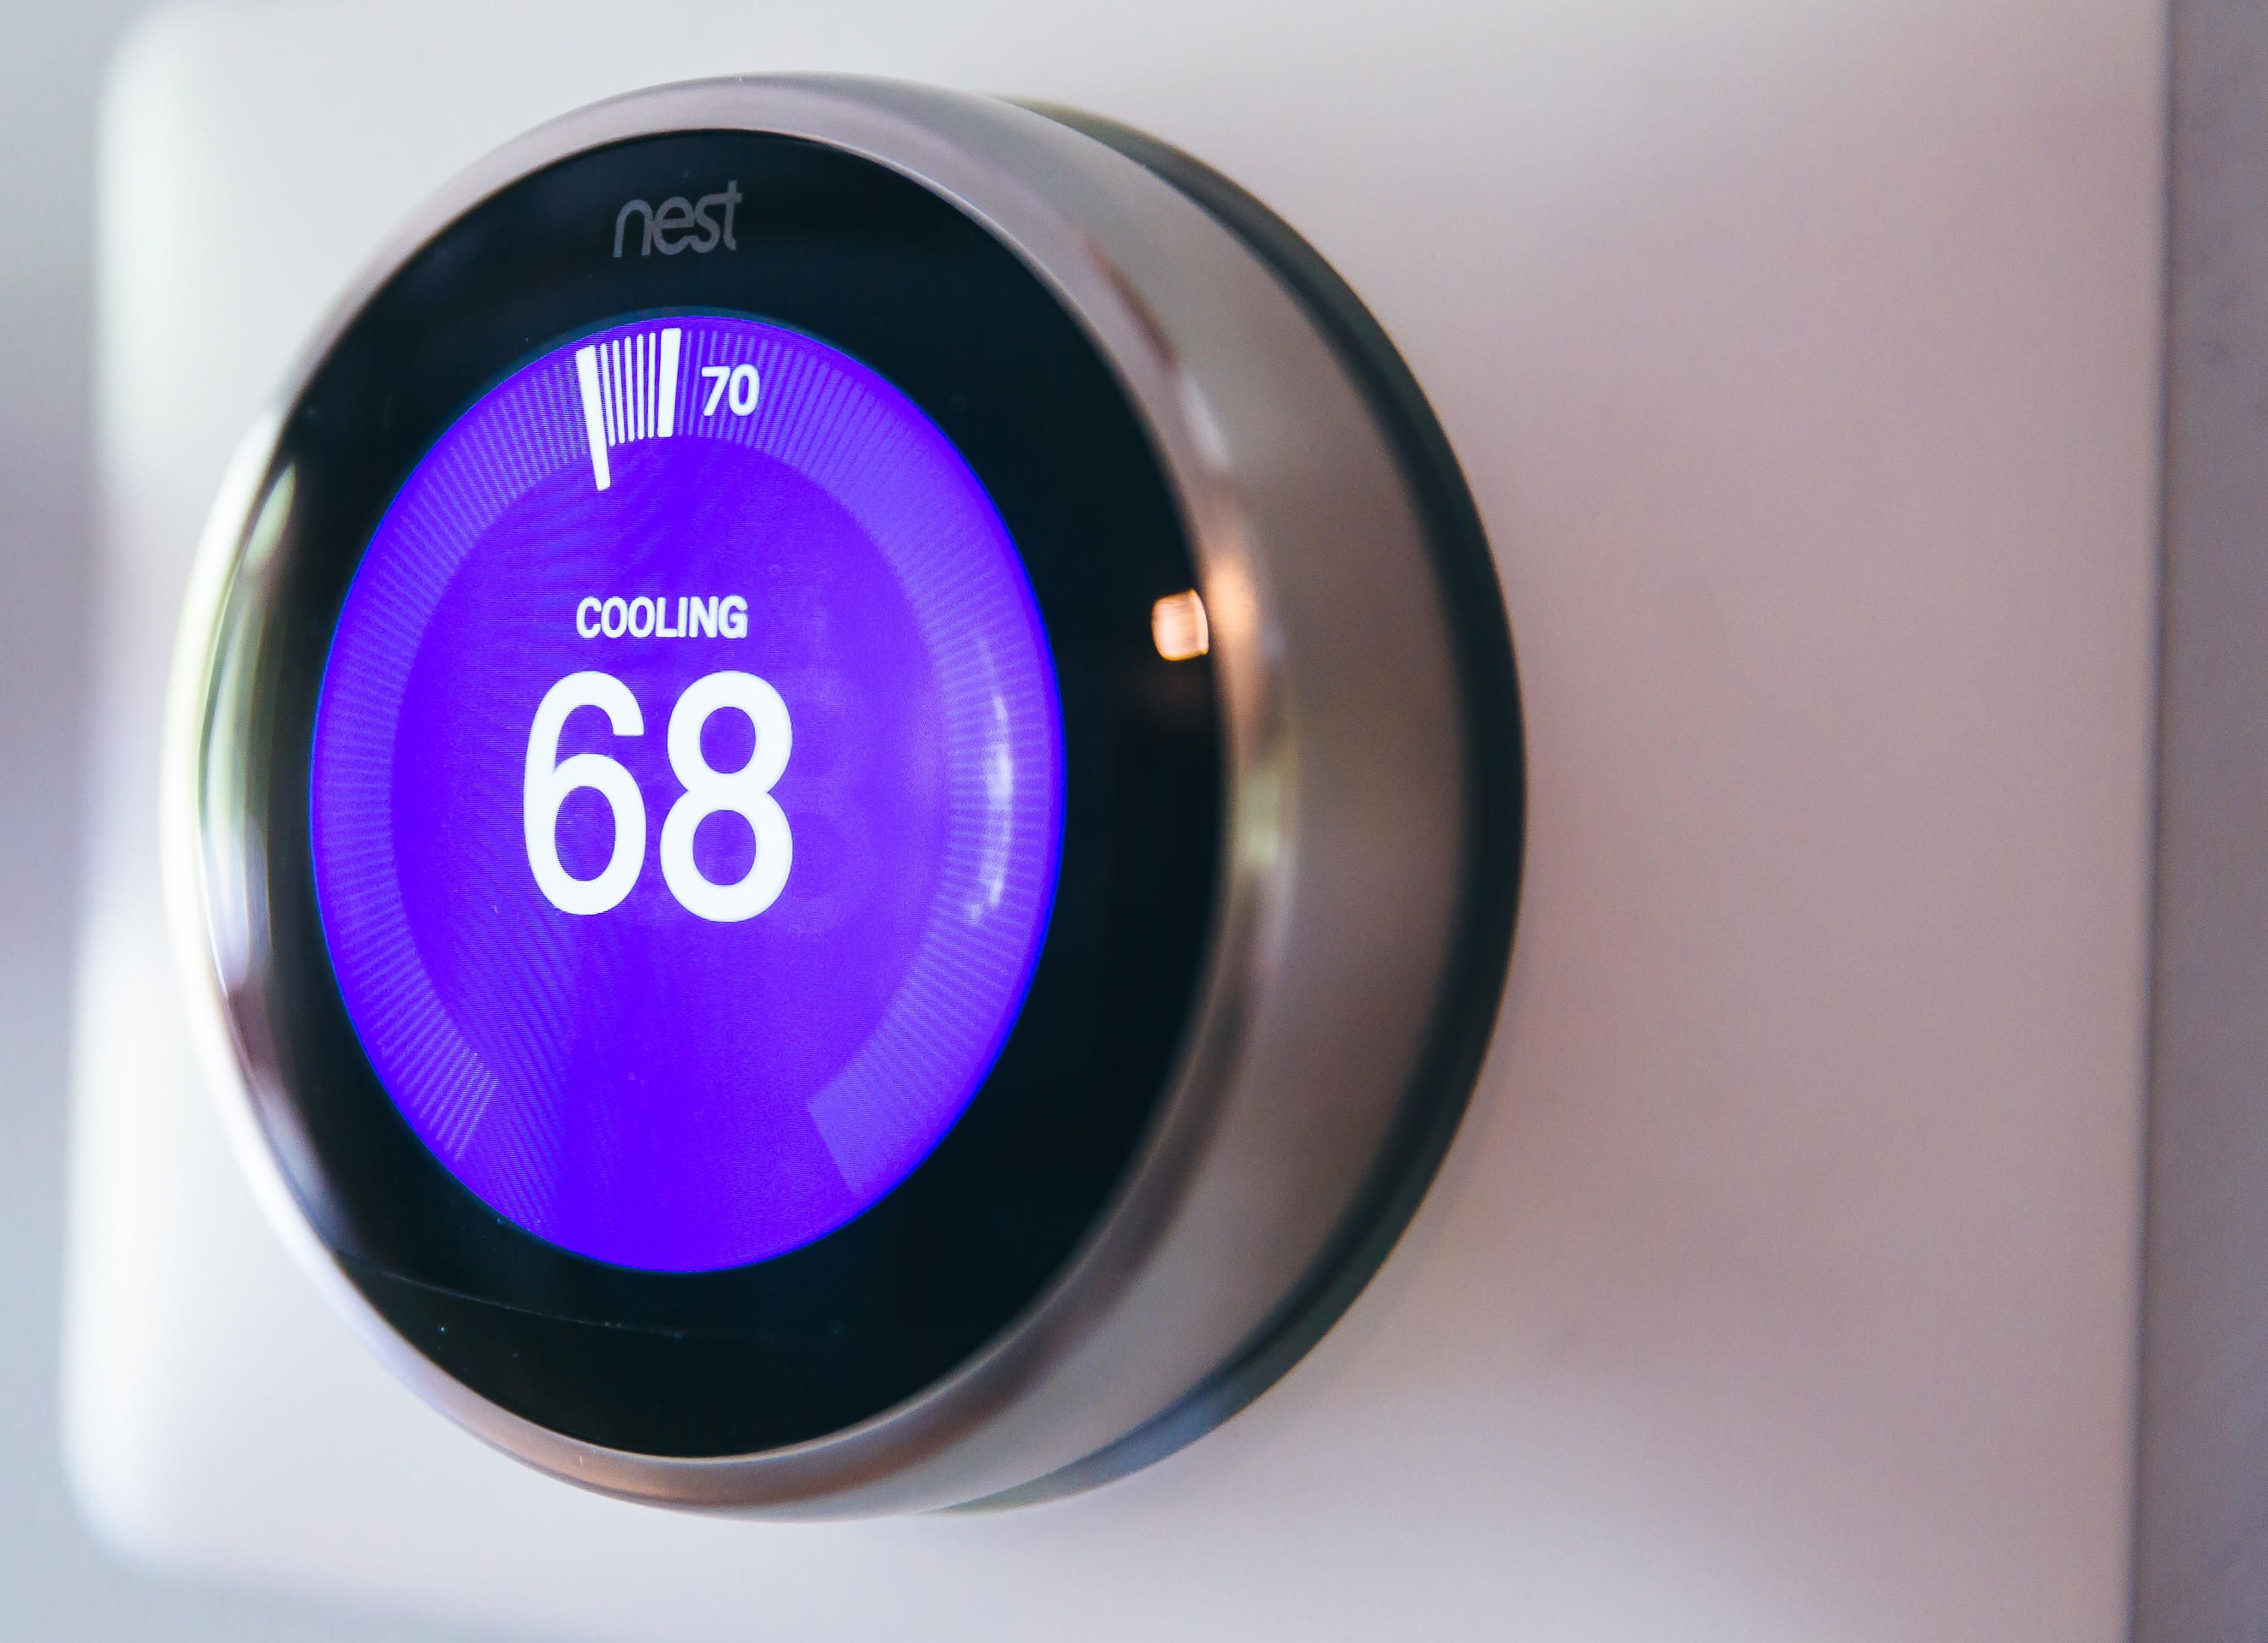


Internet of Things (IoT)
What is it?
The act of giving everyday objects the ability to talk to the internet

Slide 13

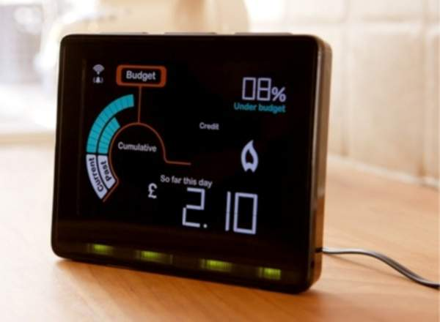
Internet of Things (IoT)
How is it being used in the energy industry?
Smart Grid Sensor
Smart Meter
Allows for monitoring equipment such as transformers and powerlines
Measures consumption of energy, water, or gas of a building or home

Slide 14
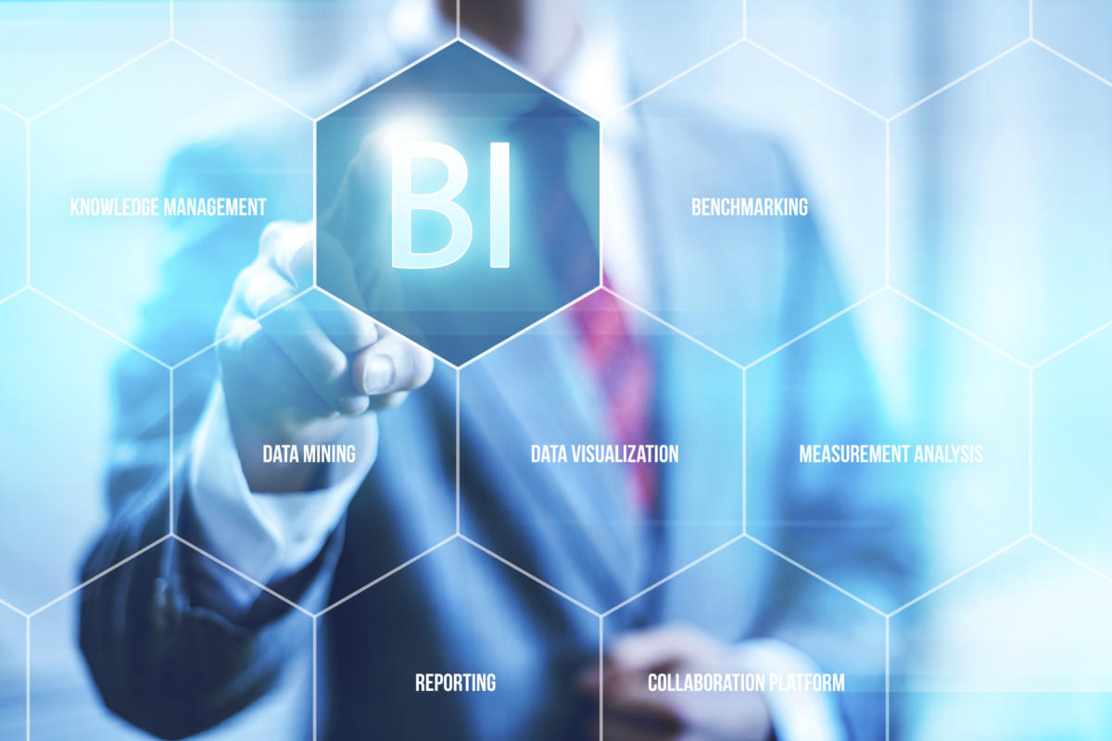
Cloud Computing
Internet of Things
Business Intelligence
Artificial Intelligence
Digital Twins

Slide 15




Business Intelligence (BI)
What is it?
Comprises the strategies and technologies used by enterprises for the data analysis of business information.
Notes:
HelloFresh - centralizes digital marketing to increase conversions
Problem: Digital marketing reporting was time-intensive, manual, and inefficient.
REI - analyzes membership actions to understand where to focus time
Problem: Difficulty tracking membership metrics with 90 terabytes of data
Coca-Cola - maximizes operational efficiency
Problem: Manual reporting processes restricted access to real-time sales and operations data.
Chipotle - has a unified view of restaurant operations to save thousands of man hours
Problem: Disparate data sources hindered teams from seeing a unified view of restaurants.

Slide 16
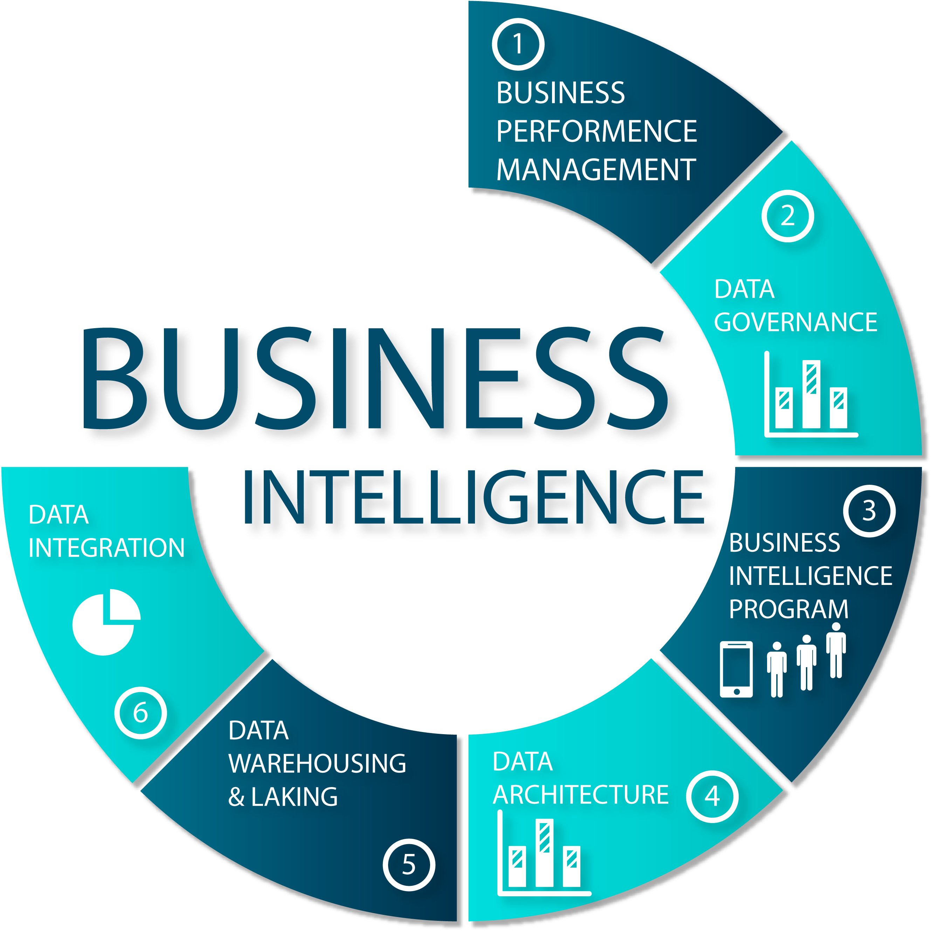
Business Intelligence
How is it being used in the industry?
Track health and environmental milestones at every step
Enhance business decisions based on energy market forecasts
Reduce downtime and improve worker safety and productivity
Systematically predict changes in marketplace demand
Balance resources and asset integrity without compromising cost

Slide 17

Cloud Computing
Internet of Things
Business Intelligence
Artificial Intelligence
Digital Twins

Slide 18




Artificial Intelligence (AI)
What is it?
Intelligence demonstrated by machines
Notes:
- IBM Watson – Jeopardy
- Ridesharing – Calculating cost
- Google Maps – Traffic predictions
- Commercial flights – autopilot
*Fun fact: on average, there is only 7 minutes of manual flying!

Slide 19

Artificial Intelligence
How is it being used in the energy industry?
Predictive maintenance
Load forecasting
Energy theft protection
Customer insights

Slide 20
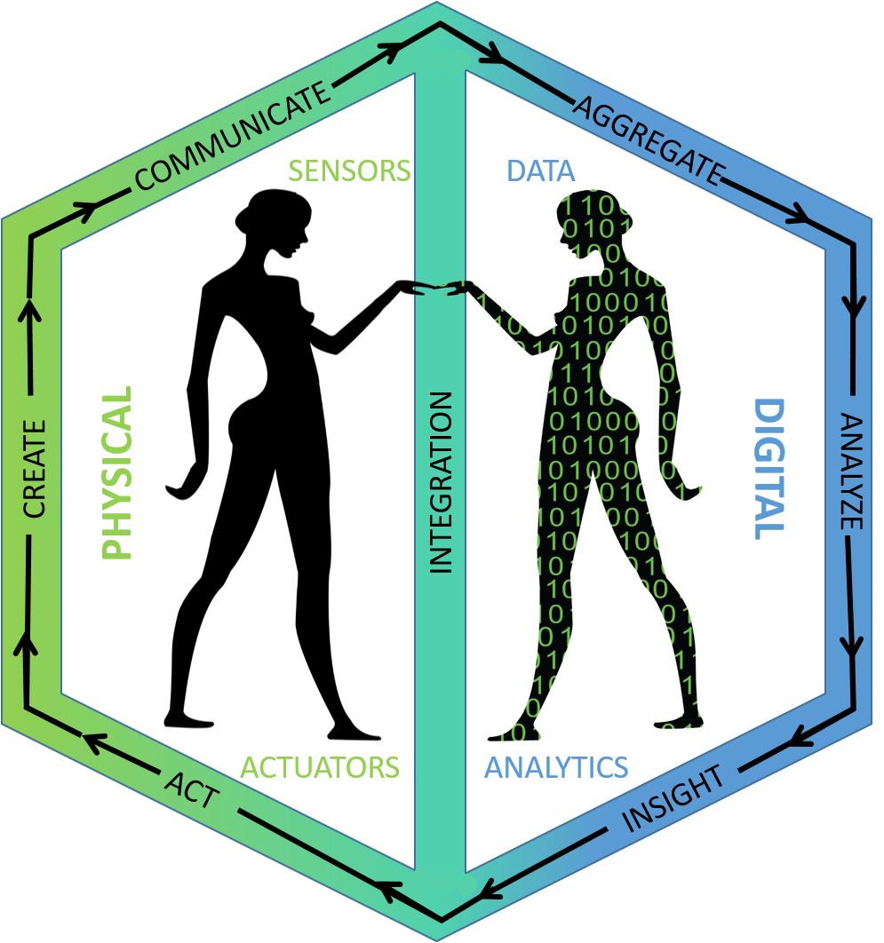
Cloud Computing
Internet of Things
Business Intelligence
Artificial Intelligence
Digital Twins

Slide 21


Digital Twins
What is it?
The act of building a digital model of the physical world, thus creating a digital replica to be able to simulate changes before implementing them.
Leverages IoT sensors to gather data of the physical world
Notes:
Singapore
Smart city
Understand how the city works and how could be improved
Visualize/plan changes
Detect traffic patterns
Actively measuring temp, pressure, humidity, light, noise level, infrared temp, motion and step counting
Formula 1
Actively measures performance of car and how it an be improved
Drivers can use simulations to drive courses without physically driving them

Slide 22
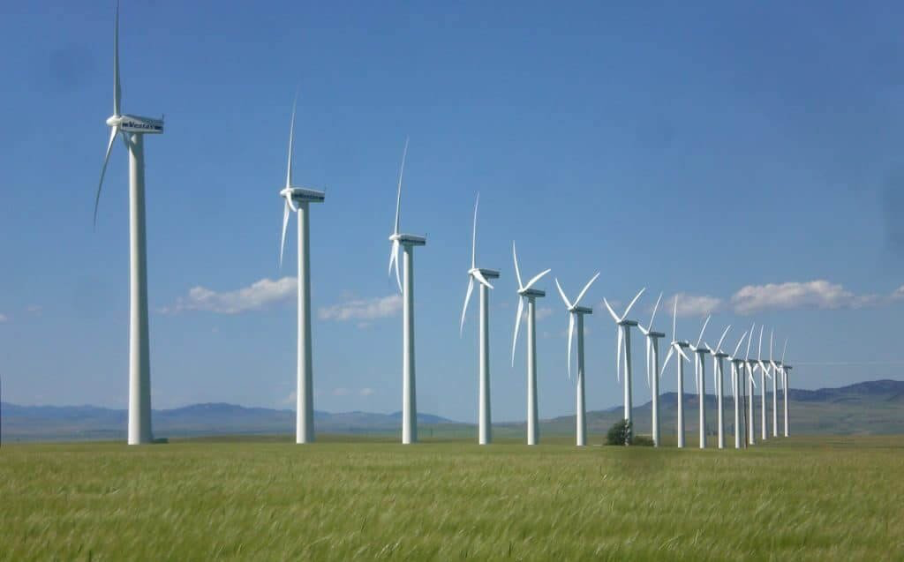


Digital Twins
How is it being used in the energy industry?
Wind farms
Detect precisely how hard they can run without burning them out
Shell
Improved operations, maintenance, and safety
Chevron
Plans to save millions on maintenance each year by 2024

Slide 23
Next Steps
What actions can I take?

Slide 24

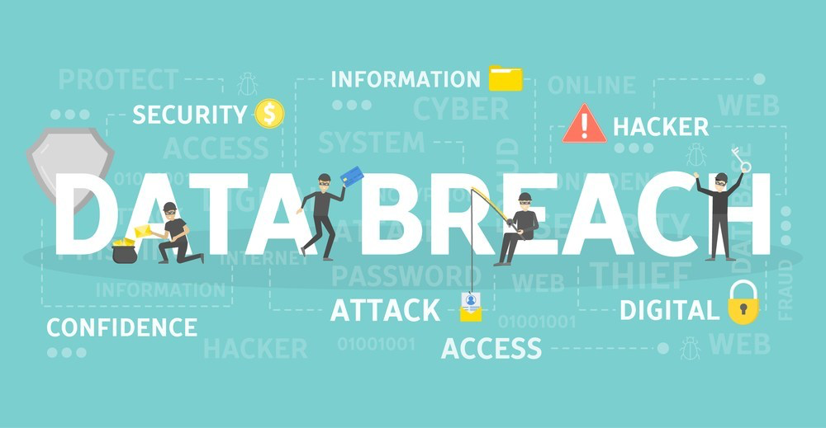




Next Steps
What actions can I take?
Must have established security practice in place

Slide 25
Next Steps
Identify cloud provider
Create migration strategy
Identify topology
Identify cloud needs
Migrate one logical piece at a time
Maintain and monitor
Cloud Computing

Slide 26
Next Steps
Internet of Things (IoT)
Scout IoT manufacturers that are security minded
Identify Smart Grid and Smart Meter locations
Install Smart Grids/Meters
Ensure data is being sent to the cloud
Monitor/Maintain

Slide 27
Next Steps
Business Intelligence
Determine stakeholder objectives
Identify your key performance indicators (KPI)
Identify the technologies and reporting tools
Implement a phased approach
Notes:
Languages
Python
R
SAP
Hadoop
Tools
Microsoft Power BI
Tableau
SAP Business Intelligence
Qlik

Slide 28
Next Steps
Identify the problem(s) that need solved
Formulate team of experts and internal staff
Consider ethics policy
Start small and expand
Artificial Intelligence
Notes:
Possible problems: predictive maintenance and load forceasting

Slide 29
Next Steps
Digital Twins
Ensure
Ensure IoT security is sound
Identify
Identify physical assets to create digital twins from
Seek
Seek experts to help
Define
Define how to interact with the physical asset
Start
Start small and grow
Notes:
Special note: this is expensive!
Interactions include monitoring, controlling, simulations

Slide 30


That’s All
Great starter resources
https://thulium.co/top-5-tech-trends-for-the-energy-and-utilities-sector-in-2019/
https://www.elp.com/articles/2019/01/top-five-tech-trends-for-in-utilities-in-2019.html
https://mobidev.biz/blog/technology-trends-energy-oil-industry
Mark Kovacevich – mark.kovacevich@improving.com - ‭(614) 395-0848‬
Chris Steele – chris.steele@improving.com – (614) 989-0878

Slide 31
References
https://emerj.com/ai-sector-overviews/everyday-examples-of-ai/
https://www.nytimes.com/2015/04/07/science/planes-without-pilots.html?_r=0
https://www.elp.com/articles/2019/01/top-five-tech-trends-for-in-utilities-in-2019.html
https://thulium.co/top-5-tech-trends-for-the-energy-and-utilities-sector-in-2019/
https://mobidev.biz/blog/technology-trends-energy-oil-industry
https://cloudacademy.com/blog/cloud-migration-benefits-risks/
https://www.forbes.com/sites/bernardmarr/2019/04/23/7-amazing-examples-of-digital-twin-technology-in-practice/#1bee52116443
http://www.apics.org/sites/apics-blog/think-supply-chain-landing-page/thinking-supply-chain/2018/09/21/real-benefits-from-digital-twins
https://www.ns-businesshub.com/technology/digital-twin-examples-formula1-singapore/

Slide 32
References
https://ifwe.3ds.com/construction-cities-territories/3dexperiencityr
https://live-newstatesman-b2b.pantheonsite.io/alternative-energy-storage-coal-mines-hydrogen/
https://www.tableau.com/learn/articles/business-intelligence-examples
https://ercim-news.ercim.eu/en115/special/2096-digital-twins-as-r-d-accelerators-the-case-for-an-open-source-ecosystem
https://www.datapine.com/blog/roadmap-to-a-successful-business-intelligence-strategy/
https://www.pcmag.com/article/350965/10-steps-to-adopting-artificial-intelligence-in-your-business
https://www.techrepublic.com/article/five-steps-for-getting-started-with-ai-in-your-business/
https://blogs.opentext.com/how-do-you-create-a-digital-twin/
https://www.networkworld.com/article/3280225/what-is-digital-twin-technology-and-why-it-matters.html

